Slide 1
Chapter 3:
Bipolar Junction Transistors

Slide 2
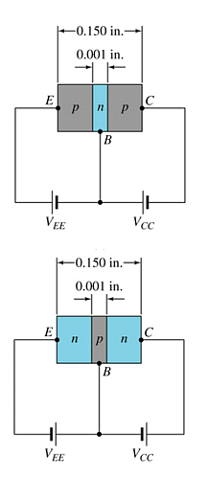
Transistor Construction
There are two types of transistors:
  pnp
  npn
The terminals are labeled:
  E - Emitter
  B - Base
  C - Collector
pnp
npn

Slide 3
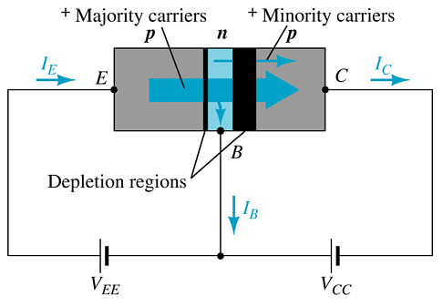
Transistor Operation
With the external sources, V_{EE} and V_{CC}, connected as shown:
  The emitter-base junction is forward biased
  The base-collector junction is reverse biased

Slide 4
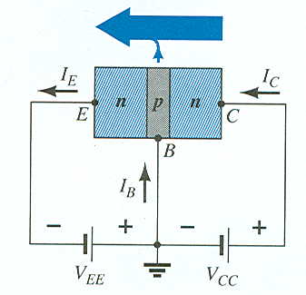

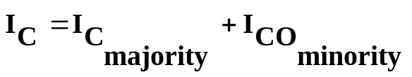
Currents in a Transistor
Emitter current is the sum of the collector and base currents:
The collector current is comprised of two currents:

Slide 5
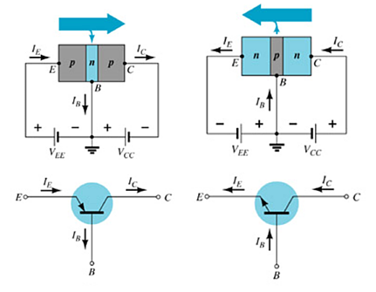
Common-Base Configuration
The base is common to both input (emitter–base) and output (collector–base) of the transistor.

Slide 6
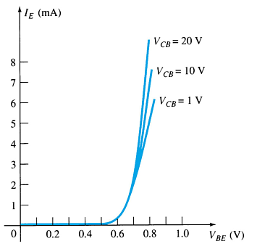
Common-Base Amplifier
Input Characteristics
This curve shows the relationship between of input current (I_{E}) to input voltage (V_{BE}) for three output voltage (V_{CB}) levels.

Slide 7
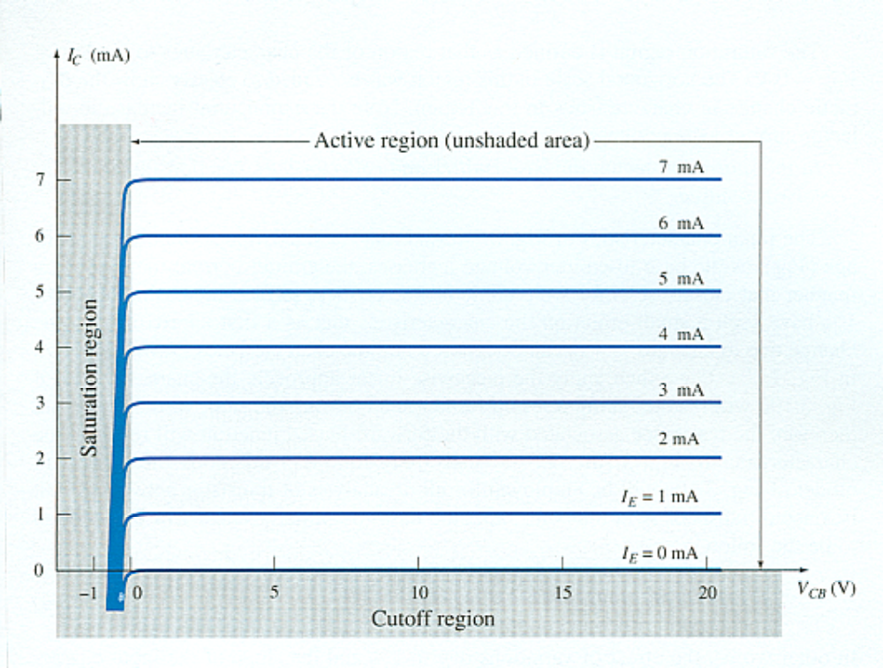
Common-Base Amplifier
Output Characteristics
This graph demonstrates the output current (I_{C}) to an output voltage (V_{CB}) for various levels of input current (I_{E}).

Slide 8
Operating Regions
Active – Operating range of the amplifier.
Cutoff – The amplifier is basically off. There is voltage, but little current. Both CB and EB junctions are reverse biased.
Saturation – The amplifier is full on. There is current, but little voltage.

Slide 9
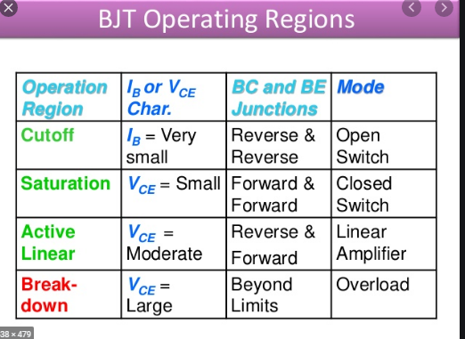

Slide 10


Approximations
Emitter and collector currents:
Base-emitter voltage:

Slide 11
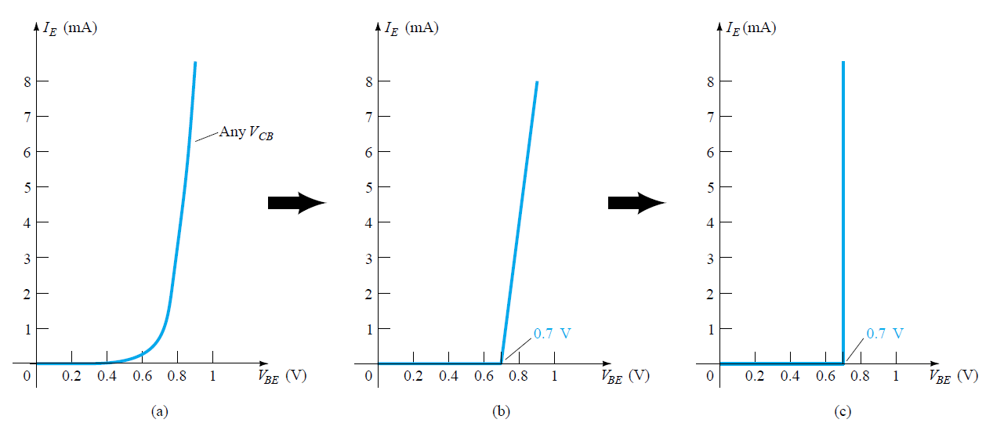
Developing the equivalent model to be employed for the base-to-emitter region of an amplifier in the dc mode.

Slide 12
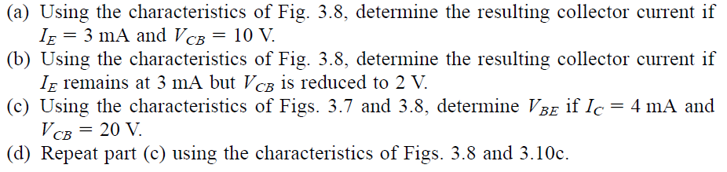
Example:

Slide 13
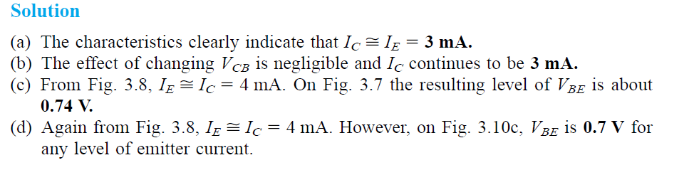
Example:

Slide 14
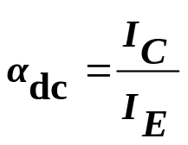
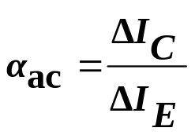
Alpha (α)
Alpha (α) is the ratio of I_{C} to I_{E} :
    Ideally: α = 1
    In reality: α is between 0.9 and 0.998
Alpha (α) in the AC mode:

Slide 15
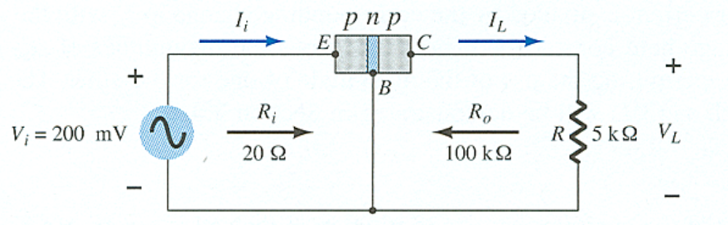
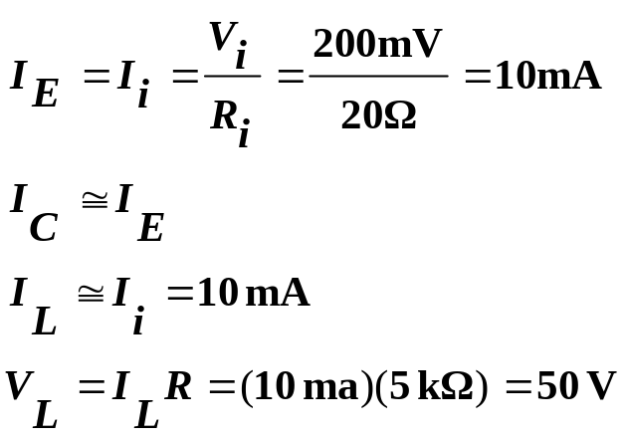
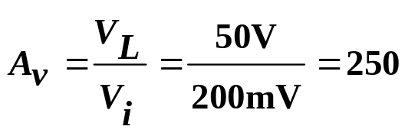
Transistor Amplification
Currents and Voltages:
Voltage Gain:

Slide 16
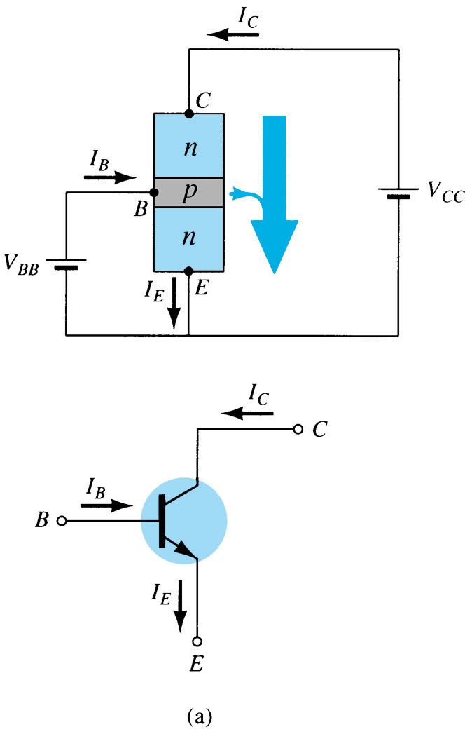
Common–Emitter Configuration
The emitter is common to both input (base-emitter) and output (collector-emitter).
The input is on the base and the output is on the collector.

Slide 17
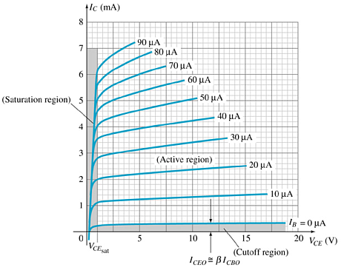
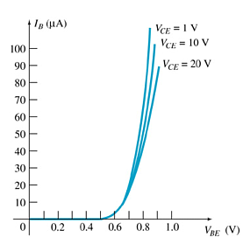
Common-Emitter Characteristics
Base Characteristics
Collector Characteristics

Slide 18
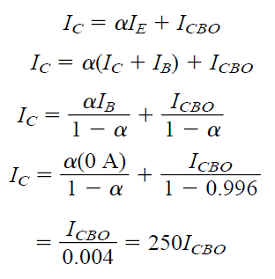
The reason for this difference in collector characteristics can be derived through the proper manipulation
For linear (least distortion) amplification purposes, cutoff for the common emitter configuration will be defined by I_{C} = I_{CEO}

Slide 19
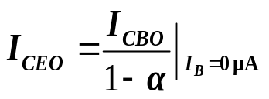
Common-Emitter Amplifier Currents
Ideal Currents
  I_{E} = I_{C} + I_{B} I_{C} = α I_{E}
Actual Currents
  I_{C} = α I_{E} + I_{CBO}
    where I_{CBO} = minority collector current
      I_{CBO} is usually so small that it can be ignored, except in high
      power transistors and in high temperature environments.
When I_{B} = 0 μA the transistor is in cutoff, but there is some minority current flowing called I_{CEO}.

Slide 20
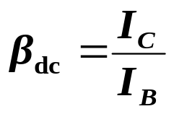
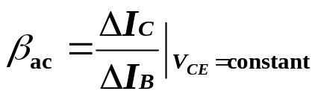
Beta (β)
β represents the amplification factor of a transistor. (β is sometimes referred to as h_{fe}, a term used in transistor modeling calculations)
In DC mode:
In AC mode:

Slide 21
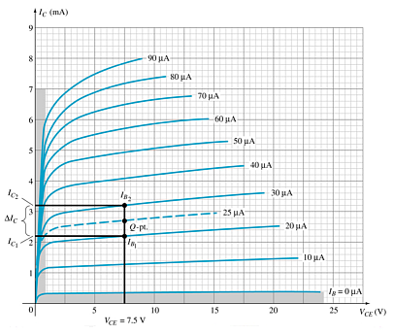
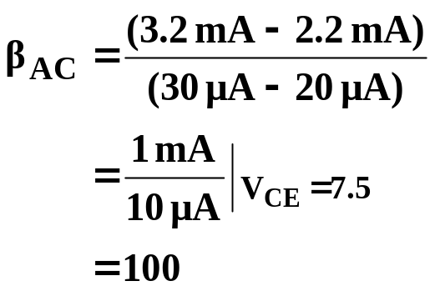
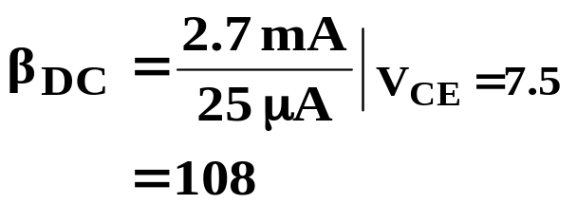
Beta (β)
Determining β from a Graph

Slide 22
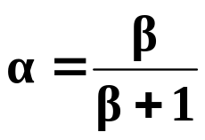
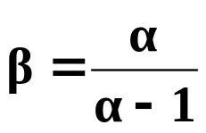


Beta (β)
Relationship between amplification factors β and α
Relationship Between Currents

Slide 23
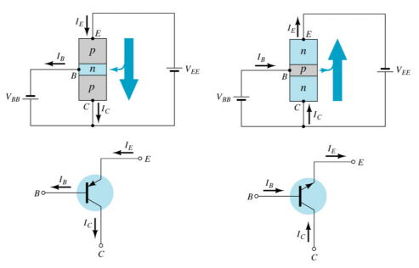
Common–Collector Configuration
The input is on the base and the output is on the emitter.

Slide 24
Common–Collector Configuration
The characteristics are similar to those of the common-emitter configuration, except the vertical axis is I_{E}.

Slide 25
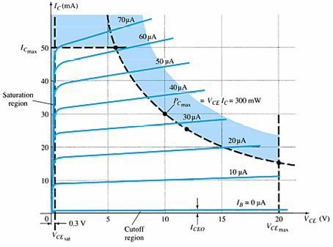
Operating Limits for Each Configuration
V_{CE} is at maximum and I_{C} is at minimum (I_{Cmax}= I_{CEO}) in the cutoff region.
I_{C} is at maximum and V_{CE} is at minimum (V_{CE max} = V_{CEsat} = V_{CEO}) in the saturation region.
The transistor operates in the active region between saturation and cutoff.

Slide 26



Power Dissipation
Common-base:
Common-emitter:
Common-collector:

Slide 27
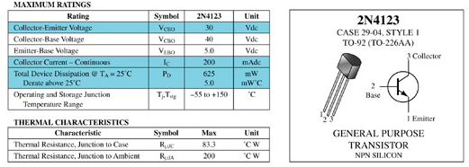
Transistor Specification Sheet

Slide 28
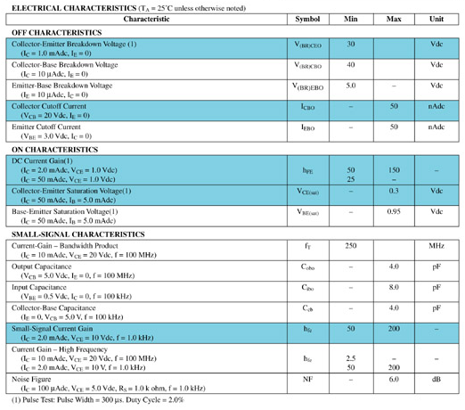
Transistor Specification Sheet

Slide 29
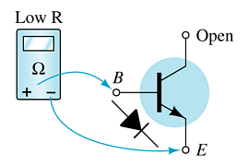
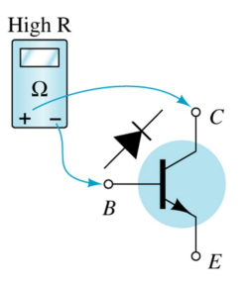
Transistor Testing
Curve Tracer
    Provides a graph of the characteristic curves.
DMM
    Some DMMs measure β_{DC} or h_{FE}.
Ohmmeter

Slide 30
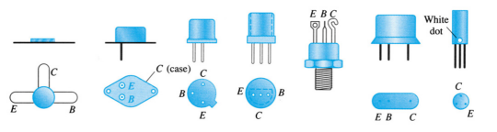
Transistor Terminal Identification

Slide 31
a) For the common-emitter characteristics of Fig. 3.14, find the β dc beta at an operating point of VCE = 8 V and IC = 2 mA.
(b) Find the value of α corresponding to this operating point.

Slide 32
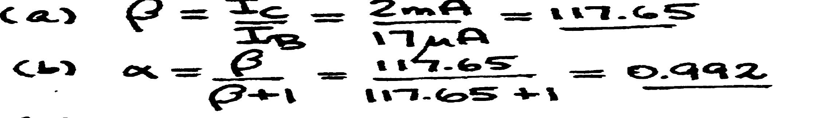

Slide 33
(a) Using the characteristics of Fig. 3.14a, determine βdc at IB = 80 A and VCE = 5 V.
(b) Repeat part (a) at IB = 5 A and VCE =15 V.
(c) Repeat part (a) at IB = 30 A and VCE =10 V.
(d) Reviewing the results of parts (a) through (c), does the value of βdc change from point to
point on the characteristics? Where were the higher values found? Can you develop any
general conclusions about the value of βdc on a set of characteristics such as those provided
in Fig. 3.14a?

Slide 34
